Slide 1
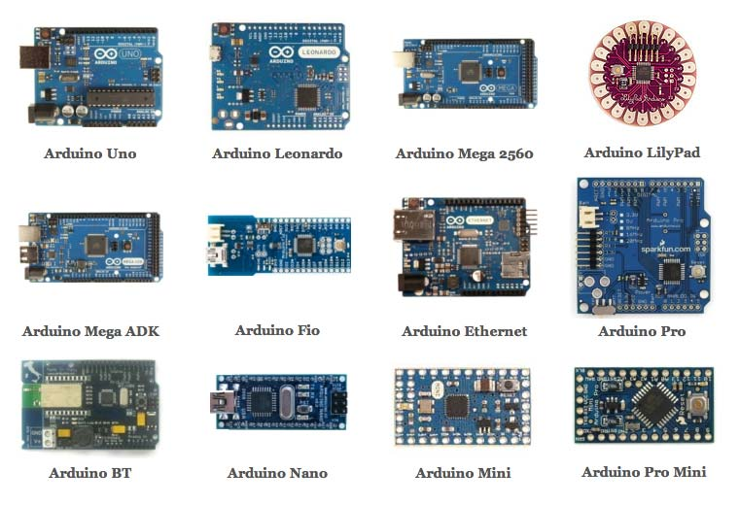
Types of Arduino Boards
Credits: Karma Laboratory

Slide 2
POWER SOURCE- to power the Arduino
USB cable connection to computer
Barrel jack to socket power supply
PINS- used to construct a circuit using wires, breadboard, components
GND(Ground) : used to provide ground connection to circuit
5V & 3.3V: supplies power to components
Vin: supplies power to components
Analog (6): analog input pins A0- A5 which support analog to digital conversion
Digital (14):
Serial: 0 (RX) and 1 (TX) used to receive (RX) and transmit (TX) TTL serial data
External Interrupts: 2 and 3 can be configured to trigger an interrupt
PWM: 3, 5, 6, 9, 10, and 11
LED: 13 controls the built-in LED

Slide 3
OTHER HELPFUL PARTS Reset Button
Pushing it will temporarily connect the reset pin to ground and restart any code that is loaded on the Arduino. This can be very useful if your code doesn’t repeat, but you want to test it multiple times.
Main IC(Integrated Circuit)
Think of it as the brains of our Arduino. The main IC on the Arduino is slightly different from board type to board type, but is usually from the ATmega line of IC’s from the ATMEL company. This can be important, as you may need to know the IC type (along with your board type) before loading up a new program from the Arduino software. This information can usually be found in writing on the top side of the IC.

Slide 4
Prep for Quiz
Pin names
Pin positions
Pin connections
Number of different types of pins.eg. 6 analog pins
Difference between using Vin and 3.3/5V
Significance of the number 1023
Pulse width modulation (PWM) (in own words not from wiki pls)
IC used in Arduino UNO
Discussion will be allowed, groups can bring an Arduino UNO to look at for reference while answering the quiz

